Slide 1
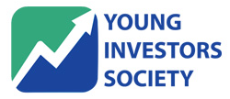
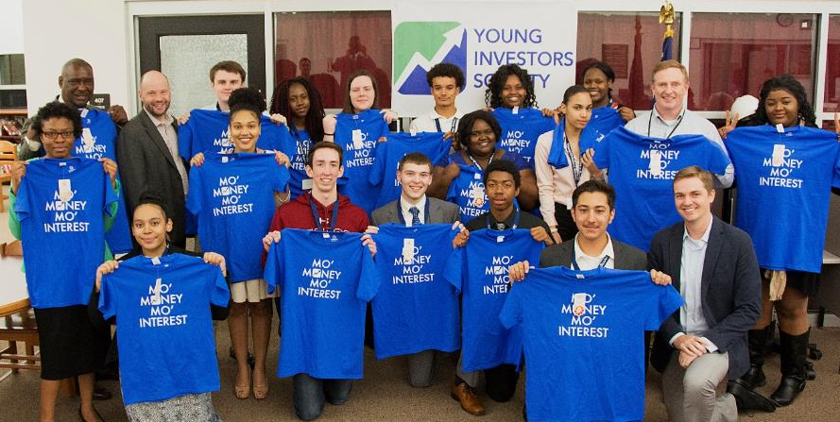
2017-2018 Introduction

Slide 2
Who is YIS?
The Young Investors Society (YIS) is a 501(c)(3) not-for-profit student organization. It was established in 2014 by James Fletcher, portfolio manager at Kayne Anderson Rudnick Investment Management.
The Young Investors Society is dedicated to preparing the next generation of investors. Its mission is to inspire youth to be outstanding long-term investors – investors in companies, investors in their communities and investors in themselves.
High-School Sponsored Clubs, Online Lessons, Stock Pitch Competition, Dollar-A-Day Challenge, CYFA Designation (Coming Soon)
Background
Mission
Programs

Slide 3
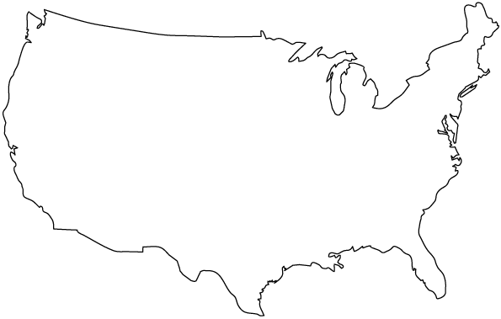
YIS – 80+ Schools Across the Country
Craig Everett, Professor and Director of Capital Markets at Pepperdine University
Andy Davis, Associate Vice President at Steel Peak Wealth Management, LLC
George Kamide, Director of Marketing at Merkle I RKG
James Fletcher, CFA, Portfolio Manager at Kayne Anderson Rudnick
Mike Zisa, Author, Teacher at Pennsbury High School
Ben Fletcher, Corporate Development at Google
Jane Winslow, Senior VP at Merrill Lynch
Valerie Funk, Director of Online Curriculum at Harvard Business Schools (HBX)
Lee Mackay, Attorney at Nevers, Palazzo, Packard, Wildermuth & Wynner
Dave Miles, CFA, Analyst at Fidelity Investments
Claudio Brocado, Portfolio Manager at Batterymarch and Fidelity
Layne Fletcher, Strategy at Booz Allen
Rory Olson, CEO at Wall Street Survivor
*Wide National Reach
Directors across the country

Slide 4
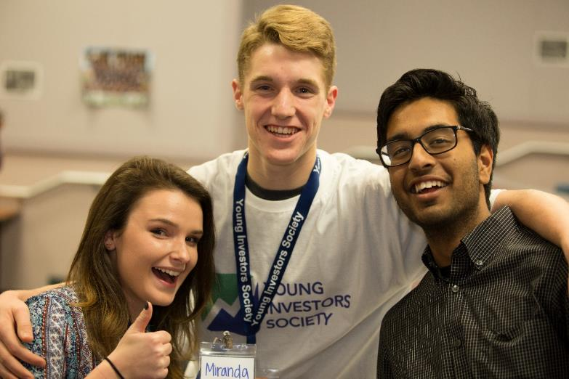
2017-18 YIS Promo Video
https://www.youtube.com/watch?v=jXxibJYxAA0

Slide 5
Why Should You Learn About Investing?
College & Career Preparation – 40% of top MBA students go into finance. We partner with top Universities across the country.
You can make money, (a lot of it if you start investing early!) Good investing = WEALTH
Investing teaches you about almost everything: business, strategy, economics, accounting, and pubic speaking.
Everyone is an investor! We will all have savings to invest and retirement to plan for during our lives.

Slide 6
Pop Quiz
QUESTION:
If you start investing $1,000 per year at age 15, how much money would you have by the time you retire (at age 65) if you achieve a 10% return per year (the stock market average)?

Slide 7
Pop Quiz
QUESTION:
If you start investing $1,000 per year at age 15, how much money would you have by the time you retire (at age 65) if you achieve a 10% return per year (the stock market average)?
ANSWER:
$1,629,074

Slide 8
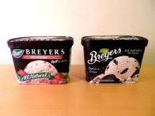
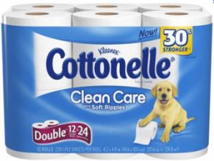
What Type of Investor are You?
At a Grocery Store: Which one would you buy?
3 Cartons of Ice Cream– $10.
Latest Blockbuster movie $10.
3lb Pack of Filet Mignon $10.
12 pack of toilet paper $10.

Slide 9
What Type of Investor are You? Part 2
At a Grocery Store: Which one would you buy?
Short-term gain=
Growth Investor
Latest & Greatest =
Momentum Investor
Quality at a Good Price =
Quality Investor
Cheap and practical =
Value Investor

Slide 10
What Does it Take to Become an Investor?
Portfolio Manager
CFA (3 Tests)
Analyst
Summer Internship
Read… A lot. WSJ, Economist, Books
4 Year College Degree – Finance
Learn what makes a good business, volunteer
Start Investing - personal, investment clubs (YIS)

Slide 11
YIS Programs
If you invest $1/day starting at age 15, by the age of 70 this could accumulate to $1.5 million dollars. Encourage these habits by 1x1 matches.
The flagship competition for YIS each year is the National Stock Pitch Competition. Teams of two compete to pitch the best stock idea to professionals
Lesson Plans taught by the brightest minds in the industry. Participate in competitions with prizes.
(Coming Soon) Qualify to earn the Certified Young Financial Analyst (CYFA) Designation, a highly prestigious award that is recognized by Universities.
Dollar-A-Day Challenge
National Stock Pitch Competition
Courses
CYFA Designation

Slide 12
Important Dates to Remember
Dollar-A-Day Challenge
Sponsorship scholarship essays due December (date TBD) To win, you need to 1) start investing $1/day and 2) write an essay, then we match your $1/day contribution up to $365.
Stock Pitches due March (date TBD)
Stock Pitch Competitions to take place in April/May (dates TBD)
National Stock Pitch Competition

Slide 13
How do you want to approach YIS?
Module 1
The Five Steps to Financial Freedom.
A 6 week course that covers career planning, budgeting and basic investing.
The course is OPTIONAL
Stock Investing 101
Our flagship material! A 24 week course that teaches you how to pick stocks and analyze companies. 7 Units to prepare you for the Stock Pitch Competition.
Module 2

Slide 14
How do you want to approach YIS?
Module 1
The Five Steps to Financial Freedom.
Stock Investing 101
Module 2
Take a vote: Do you want to do Module 1 or skip straight to Module 2?

Slide 15
The Power of $1 a day
Age 15: Saving $1/day = drinking one less can of soda
Age 70:
Net Worth $1.5 million
@ 11%
Age 70:
Net Worth $26 billion
(about the size of the economy of Bolivia)
Age 70:
Net Worth
$3.1 million
@ 11%
@ 11%
with a 1x1 match
1x1 matches:
3,455 students
Notes: 11.0% is the historical average return of the S&P 500 from 1928-2015

Slide 16
Partners and Sponsors

Slide 17
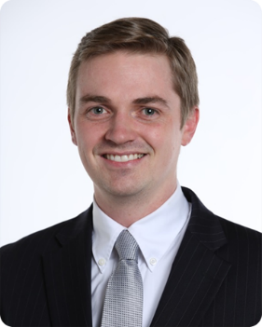
YIS: Founder’s Story
https://www.youtube.com/watch?v=ZsCHuHNYWLE
James Fletcher, CFA

Slide 18
Pop Quiz
QUESTION:
In 2005 you invested $10,000 in Priceline (PCLN)? How much is that investment worth today? Who can get the closest?

Slide 19
Pop Quiz
ANSWER:
$53 million dollars! (PCLN is up 5,345%)

Slide 20
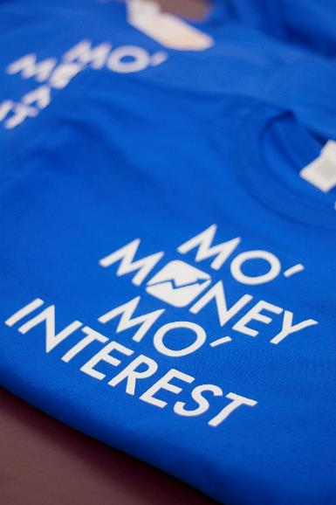
Young Investors Society
See you next meeting!
Follow YIS for news, updates, and contests!
WWW.YIS.ORG

