Slide 1
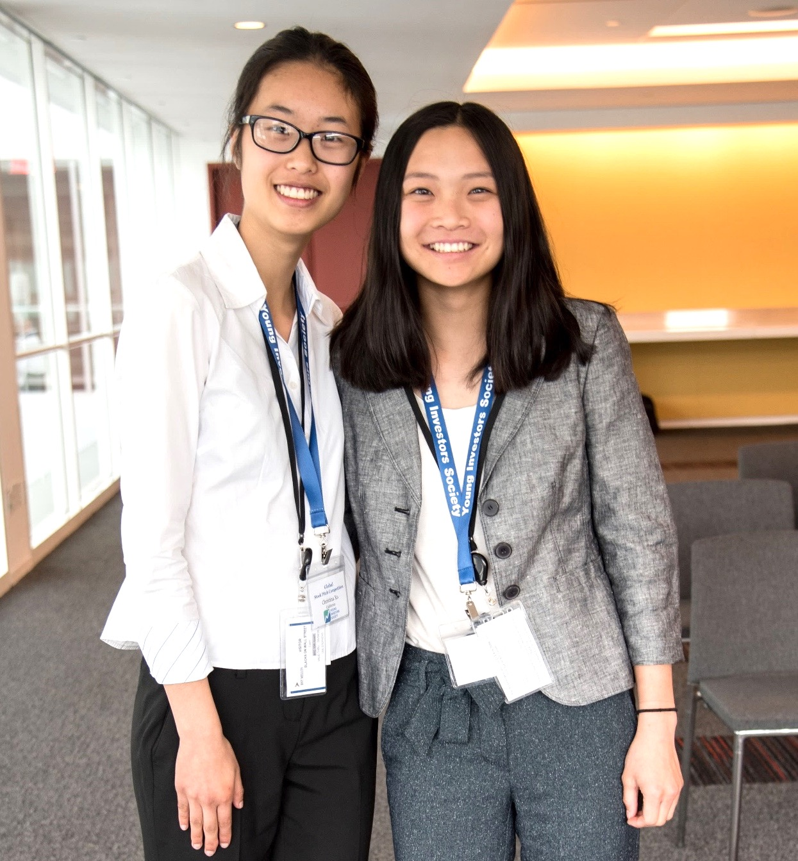
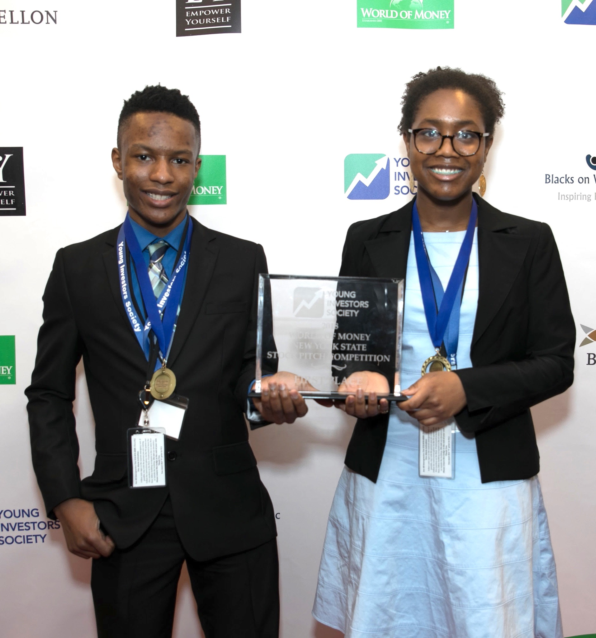
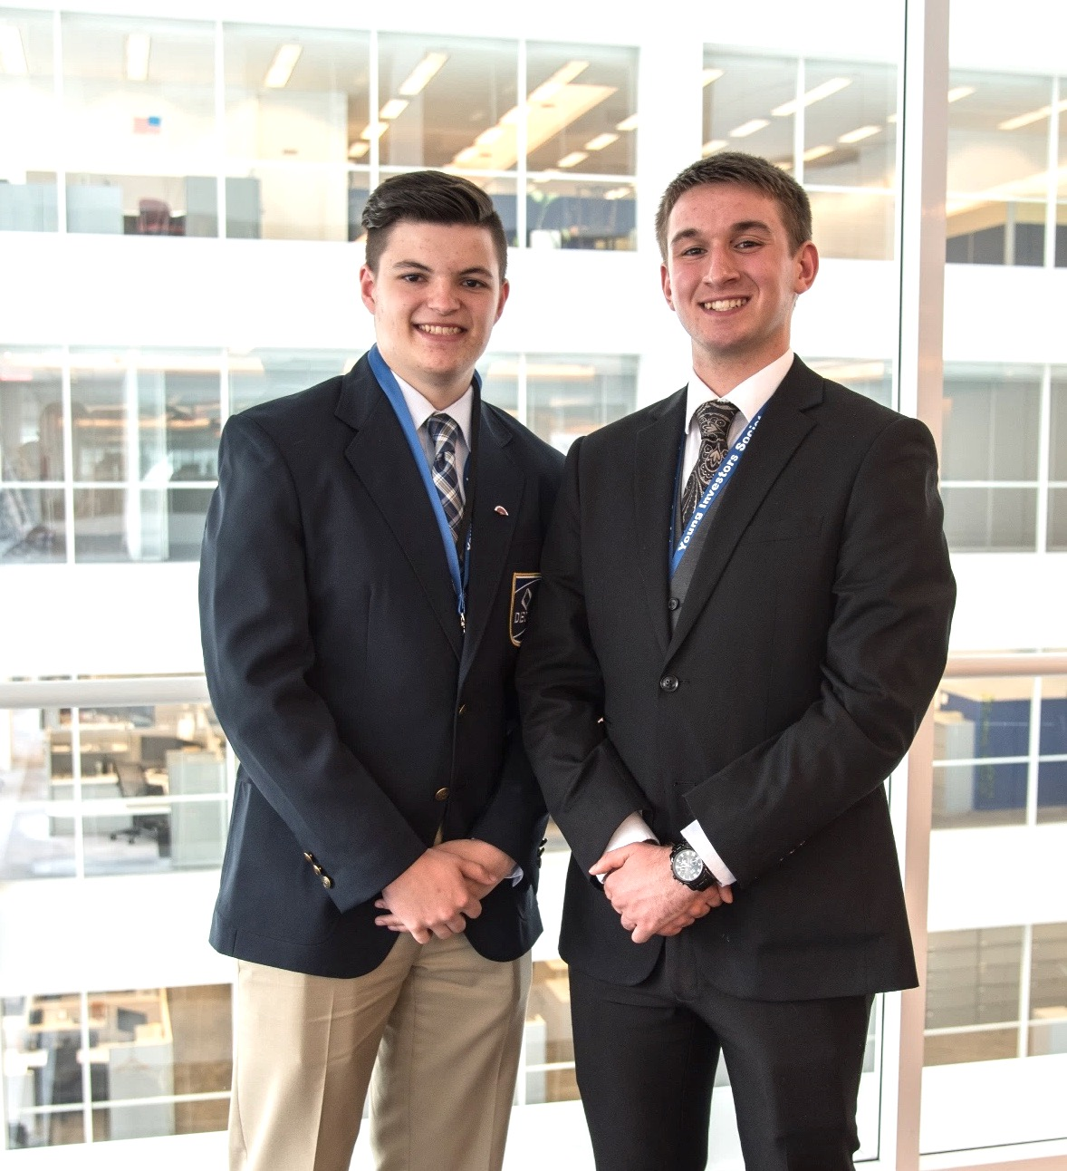
FIRST CLUB MEETING
2019-2020

Slide 2
YIS Interview with Mark Cuban
Mark Cuban Promo Video
YIS Mark Cuban Intro
https://www.youtube.com/watch?v=k4WJFksTINE

Slide 3
BACKGROUND
Young Investors Society
Background
Young Investors Society (YIS) is a 501(c)(3) nonprofit organization. It was founded in 2014 by James Fletcher, CFA, Portfolio Manager at APG Asset Management and other successful investors and business professionals.
Mission
YIS is dedicated to preparing the next generation of investors.
Our mission is to inspire youth to be outstanding long-term investors – investors in companies, investors in communities and investors in themselves.

Slide 4
MARKET
Problem
Reality
Reality
85% of parents believe that financial education courses should be a requirement for high school graduation (LearnVest)
As of 2015, 39 states have adopted financial literacy standards as part of the Common Core State Standards (CEE)
Problem
Problem
2/3 of high-school students fail a basic financial literacy test (JumpStart)
Existing in-school programs teach about the stock market using mock-portfolios, which rewards risky behavior and short-term thinking.
Solution
Over 90% of Young Investors Society members that participate in the program successfully pass a standardized financial literacy test (2017)

Slide 5
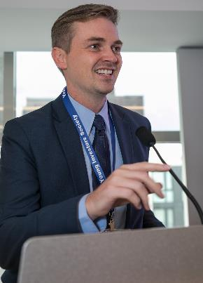
YIS FOUNDER’S STORY
Click to watch our Founder’s Story Video here:
https://www.youtube.com/watch?v=ZsCHuHNYWLE
Why Does YIS Exist?
We believe financial education in the United States and abroad is inadequate at best.
It does not begin to prepare students to manage their personal finances, let alone make responsible investment decisions in adulthood.
According to JumpStart, two-thirds of U.S. high-school students fail a basic financial literacy test.
YIS wants to change that!

Slide 6
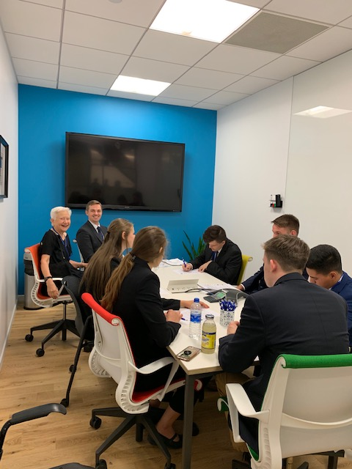
Why Learn About Investing?
Top Reasons To Learn About Investing:
College & Career Preparation: 40% of top MBA students go into finance. We partner with top Universities across the country.
You can make money, (a lot of it if you start investing early!) Good investing = WEALTH
Investing teaches you about almost everything: business, strategy, economics, accounting, and pubic speaking.
Everyone is an investor! It is an essential tool! We will all have savings to invest and retirement to plan for during our lives.

Slide 7
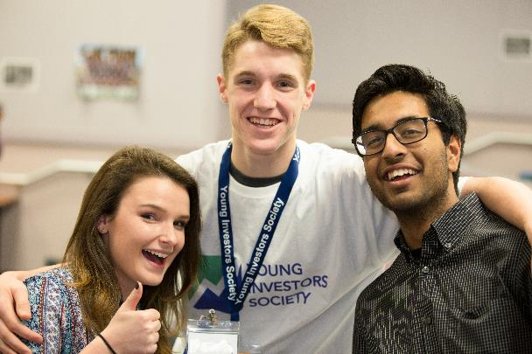
YIS Overview Video
Click to watch the YIS Overview Video here:
https://www.youtube.com/watch?v=Pr_L0kqIsWw&t=1s

Slide 8
POP QUIZ
QUESTION?
If you start investing $1,000 per year at age 15, how much money would you have by the time you retire (at age 65) if you achieve a 10% return per year (the stock market average)?

Slide 9
POP QUIZ
QUESTION?
If you start investing $1,000 per year at age 15, how much money would you have by the time you retire (at age 65) if you achieve a 10% return per year (the stock market average)?
ANSWER:
$1,629,074

Slide 10
PROGRAMS
YIS Programs Offered:
School Sponsored Clubs: YIS will teach students the skills to save and invest for their future in a fun team environment. Teacher guided and student led activities are conducted weekly in 45-minute increments after school or at lunch on high school campus locations.
“Dollar-A-Day” Challenge: YIS students can begin to invest one dollar per day into a personal brokerage account. Students learn the power of compound interest and start to actively save for retirement. Students can also compete for a FREE Money Match Scholarship by submitting a brief essay on an assigned financial literacy topic.
Stock Pitch Competition: This competition is the culmination of investment skills gained during the year and provides High School students hands-on mentoring in financial analysis. Students (individually or in teams of two) create a “best stock idea” and analyze a publicly traded company.
CYIA® Designation: In the Summer of 2018, YIS launched the Certified Youth Investment Analyst Designation for students who meet community service hour criteria, teacher recommendations, GPA criteria, and of course a timed test which will culminate questions from our Stock Pitch 101 book and the Essays of Warren Buffett.

Slide 11
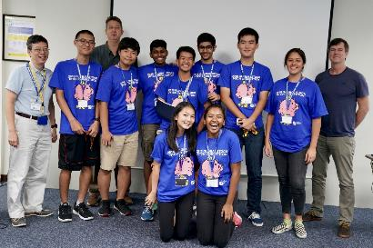
PROGRAMS
School Sponsored Clubs
After School Club Program
To ensure a rich experience, YIS teaches students to create life changing habits to save and invest for their future in a fun team environment.
Each local chapter learns the fundamentals of saving and investing.
The clubs are predominantly student-led, while overseen by a school advisor/teacher.
Students join a community of other YIS students around the world, gain leadership experience and learn many life lessons (e.g. hard work, patience, teamwork, etc.).

Slide 12
PROGRAMS
JV & Varsity Tracks
After School Club Program: JV
First year YIS Students and students brand new to investing can start their journey with our JV track.
The JV track teaches basic personal finance principles and beginner investment principles to get students ready for the JV Stock Pitch Competition.
The JV Stock Pitch Competition will focus on company assessment and valuation based on SWOT Analysis and Economic Moat.
JV & Varsity students can participate in any and all other YIS programs offered.

Slide 13
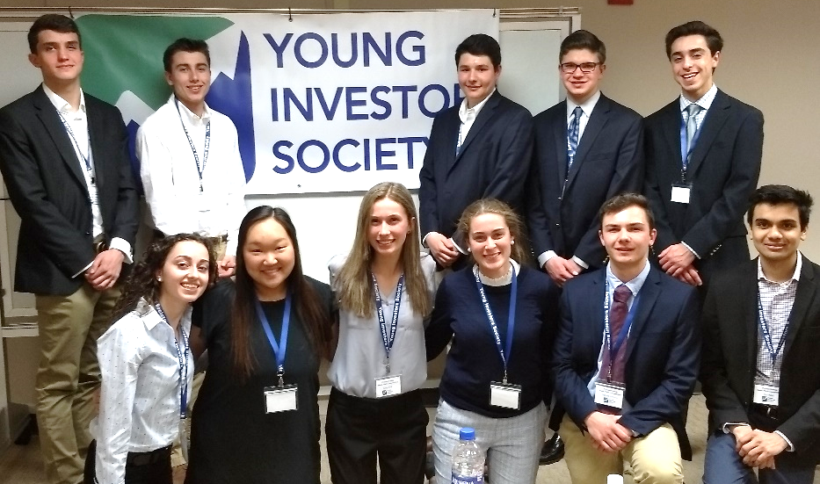
PROGRAMS
JV & Varsity Tracks
After School Club Program: Varsity
Seasoned YIS Students and students who are familiar with basic investment principles can continue their journey with the Varsity track.
The Varsity track teaches advanced finance principles and advanced investment principles to get students ready for the Varsity Stock Pitch Competition.
The Varsity Stock Pitch Competition will focus on advanced company assessment and valuation based on P/E Ratios.
JV & Varsity students can participate in any and all other YIS programs offered.

Slide 14
PROGRAMS
Personal Finance
Personal Finance Curriculum
YIS students can begin their personal finance journey and learn real-life lessons with our newest Introduction to Personal Finance Curriculum Series.
The curriculum includes lessons in Financial Psychology, Budgeting, Account Management, Credit Profile, Loans & Debt, Jobs & Careers, Entrepreneurship, Saving, and Investing

Slide 15
PROGRAMS
Start Investing NOW Giveaway
Start Investing NOW Giveaway!
Young Investors Society has launched the Start Investing Now program to encourage students to open Brokerage/Investment accounts to start investing in their future!
Students are encouraged to open brokerage/investment accounts at any financial institution (Custodial Account if under 18 years old) As an added BONUS, 50 students will be randomly selected from the first 250 entries to receive $100.00 to invest in their new account! Giveaway starts August 26th! Open your brokerage account TODAY! For more info, Visit: https://yis.org/yiscourse/specialevent/3
Start Investing NOW Giveaway starts Aug. 26th!

Slide 16
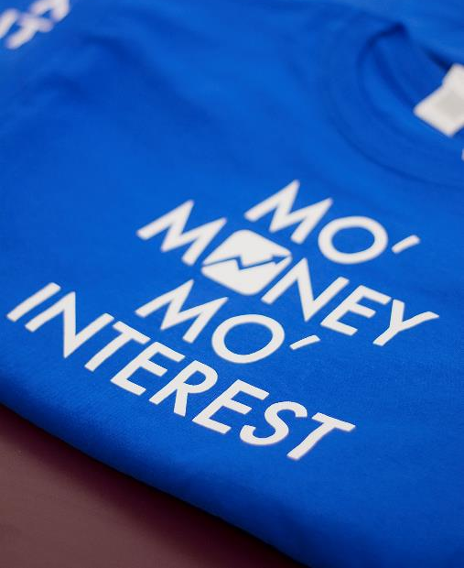
PROGRAMS
The Dollar-A-Day Challenge
The Dollar-A-Day Challenge
YIS members can begin investing today by taking the “Dollar-A-Day Challenge.”
Students can begin to invest one dollar per day into a personal brokerage account.
YIS donors that want to help students build wealth for retirement can provide a FREE Money Match scholarship for selected individuals.
Selected participants will be eligible to receive the Free Money Match scholarship that matches student contributions dollar for dollar on a quarterly basis up $90/quarter, to incentivize developing good savings habits.

Slide 17
PROGRAMS
The Dollar-A-Day Impact
AGE 15
Saving $1/day
~20% of kids awarded 1x1 match
10%
10%
or drinking one less can of soda
AGE 70
AGE 70
Net Worth
1x1
Net Worth
$1.5 million
matches
$3.1 million
1000 students
SECOND GENERATION
Age
70
Net Worth
$26 billion
Notes: 11.0% is the historical average return of the S&P 500 from 1928-2015

Slide 18
PROGRAMS
Stock Pitch Competition
Global Stock Pitch Competition
YIS’ annual flagship event is the Global Stock Pitch Competition. This competition is the culmination of investment skills gained during the year and provides High School students hands-on mentoring in financial analysis.
Each student or team writes a report on their chosen company with a “Buy” or “Sell” recommendation and then presents and defends their analysis to a panel of judges.
In 2019, over 225 students from 18 US states and four countries competed in the competition. The global finals were held in NYC sponsored by NASDAQ.

Slide 19
PROGRAMS
Stock Pitch Competition Highlights
https://www.youtube.com/watch?v=KHuClvI_dDo

Slide 20
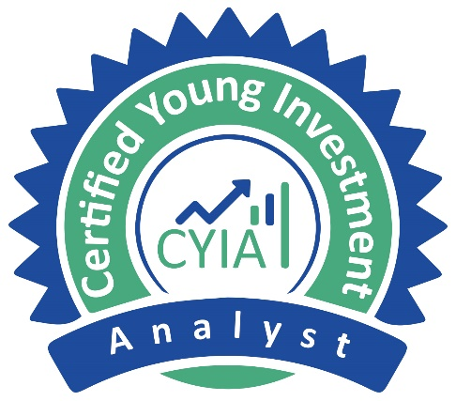
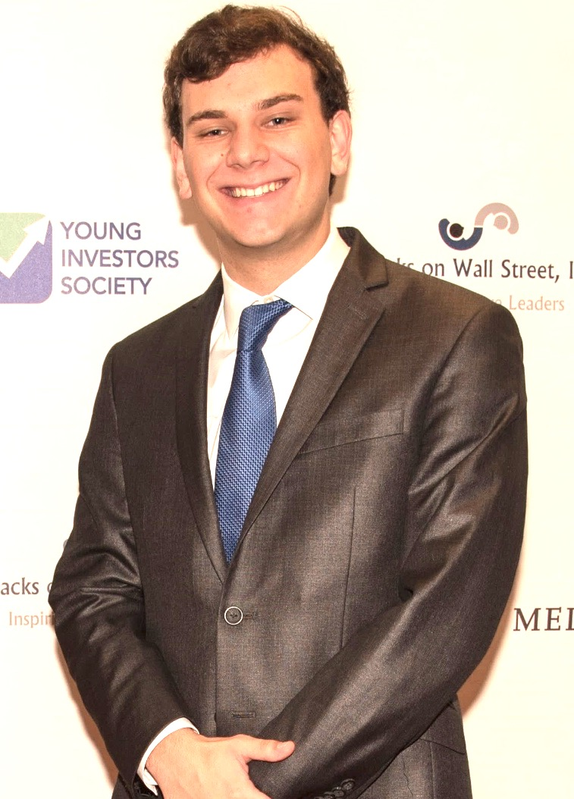
PROGRAMS
Certified Young Investment Analyst (CYIA®)
Designation
The highest honor within the Young Investors Society is to be awarded a Certified Young Investment Analyst (CYIA®) Designation.
The CYIA® Designation represents a tremendous achievement. Less than 10% of those students that enter YIS end up achieving the CYIA® Designation.
It is widely respected by Universities and future employers.
Requirements
1. Be an active member of Young Investors Society
2. Pass the online timed CYIA® exam (50% pass rate).
3. Participate in a State or Regional Stock Pitch Competition.
4. Participate in the YIS Dollar-A-Day Challenge.
5. High School Teacher or YIS Advisor Letter of Recommendation.
6. Participate in a Community Service Project – 10 hrs.
7. Minimum GPA of 3.0 or equivalent.
8. Conduct a final interview with a YIS Board Member.

Slide 21
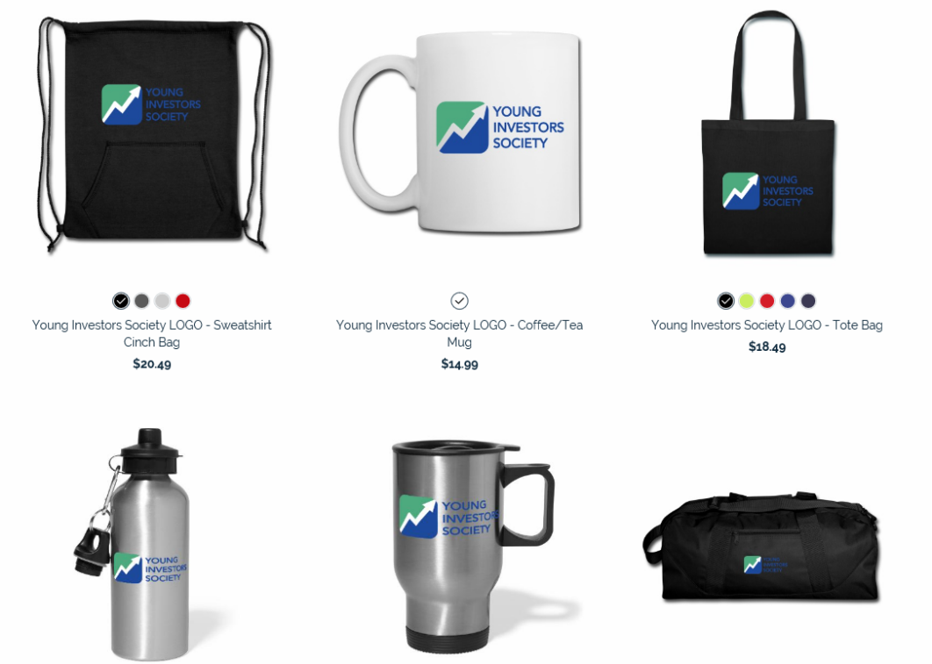
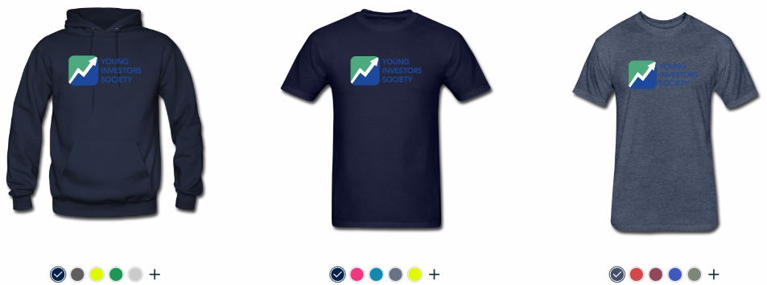
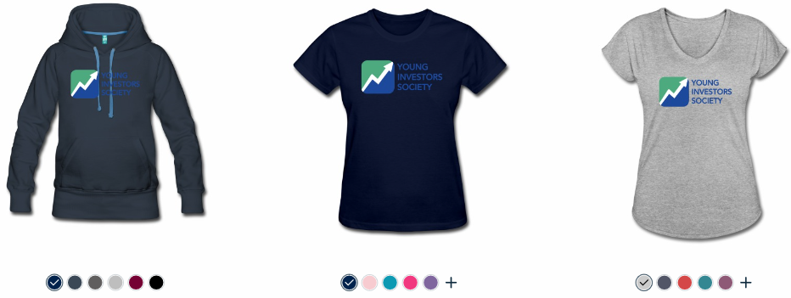
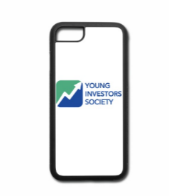
YIS MERCHANDISE
YIS Merchandise Store Now OPEN!
Click to go to the YIS Online Store:
https://shop.spreadshirt.com/young-investors-society
Get your YIS Merch!
100% of all merchandise proceeds go to fund YIS programs! Get your YIS swag today!

Slide 22
IDEA OF THE WEEK
Get Involved
What is Idea of the Week?
“Idea of the Week” is a weekly discussion that kicks off every YIS Club Meeting.
Nominate one student per week to research a company, investment topic, or financial news issue.
Student will present their “Idea of the Week to the group and have a brief discussion on the topic.
“Idea of the Week” topics can be current events in the finance industry, industry announcements, company news, and even predictions about what a company will do next.

Slide 23
IMPORTANT DATES
Mark Your Calendars
Dates to Remember
August 26 –September 30th
Back to School Recruitment: Bring a Friend to YIS
Start Investing NOW Giveaway begins
October 1st-November 30th
Dollar-A-Day FREE Money Match Applications Accepted
January 1st-January 29th
CYIA® Exam Open Online
Dollar-A-Day FREE Money Match Applications Accepted
March 1, 2020
Deadline to register for Regional Stock Pitch Competitions.
March 31, 2019
All Stock Pitch Reports & Presentations DUE
April 1-April 26, 2020
Regional Stock Pitch Competitions Held
(U.S, Online & International)
May 15, 2020
Global Stock Pitch Competition (New York City)

Slide 24
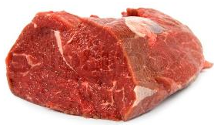
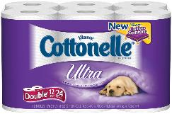
What Type of Investor Are You?
At A Grocery Store: Which Item Would You Buy?
3 Cartons of Ice Cream: $10.00
Latest Blockbuster Movie: $10.00
3lb Pack of Filet Mignon: $10.00
12 Pack of Toilet Paper: $10.00

Slide 25
What Type of Investor Are You? Part 2
At A Grocery Store: Which Item Would You Buy?
3 Cartons of Ice Cream: $10.00
Short-Term Gain=Growth Investor
Latest Blockbuster Movie: $10.00
Latest & Greatest=Momentum Investor
3lb Pack of Filet Mignon: $10.00
Quality At A Good Price=Quality Investor
12 Pack of Toilet Paper: $10.00
Cheap & Practical=Value Investor

Slide 26
POP QUIZ
QUESTION?
In 2005 you invested $10,000 in Priceline (PCLN)?
How much is that investment worth today?
Who can get the closest?

Slide 27
POP QUIZ
QUESTION?
In 2005 you invested $10,000 in Priceline (PCLN)?
How much is that investment worth today?
Who can get the closest?
ANSWER:
$53 Million Dollars!
(PCLN is up 5,345%)

Slide 28
YIS Interview with Mark Cuban
Mark Cuban Advise
YIS Mark Cuban Intro
https://youtu.be/iQqskV5vOI0

Slide 29
Follow Us On Social Media
DONATE TO YIS TODAY
Young Investors Society has regular updates and contest that are announced on our social media pages.
Follow us for the most recent news, updates, and contests!
Follow us on:
Questions?
Contact:
Christine Tobin
Chief Operating Officer
(805) 479-5292
Ctobin@yis.org
Visit our website at:
WWW.YIS.ORG

Slide 30
See You At The Next Meeting!

